Slide 1
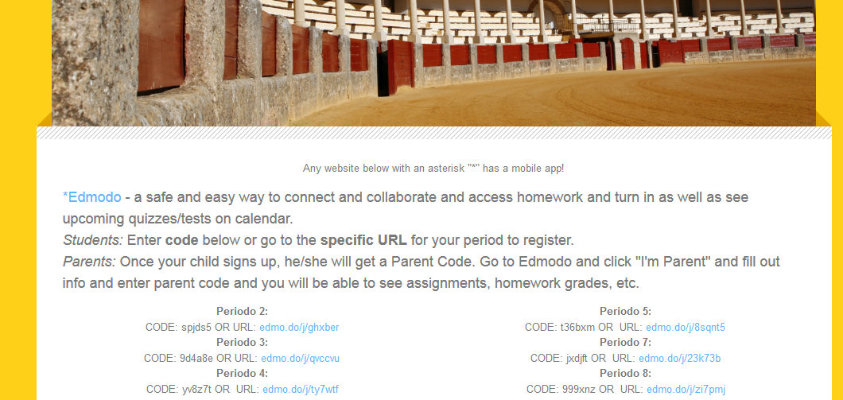
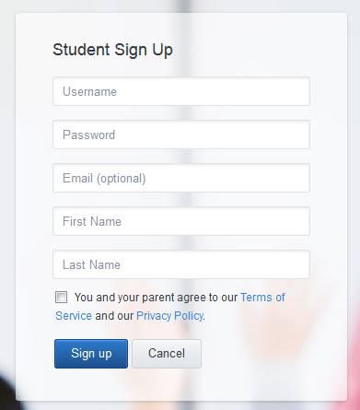
Edmodo
profeh.weebly.com
Click on your period’s link
For username: Use first name & first initial of last name
Example: First Name: Bowie Last Name: Student - Username: bowies OR bowie_s OR bowie.s
Turn in your first assignment via Edmodo now– Code of Conduct – follow instructions on Edmodo

Slide 2
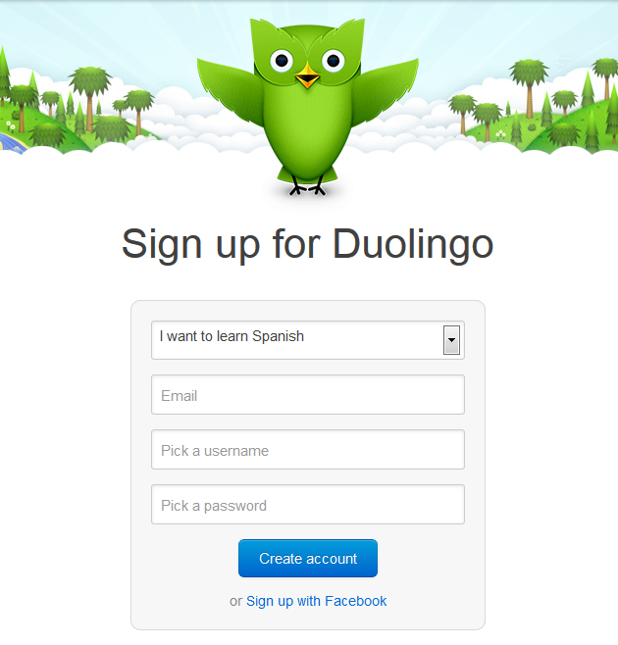
DuOLINGO
www.duolingo.com
Sign up using an email (NOT FACEBOOK)
Choose “I want to learn Spanish”
Make your username
the same as your Edmodo username!
Your first homework assignment will be posted on Edmodo tonight. Go there to see instructions. You will be using Duolingo and turning in your screen capture on Edmodo.
Día A: Entrégala 4/9 Día B: Entrégala 3/9

