Slide 1
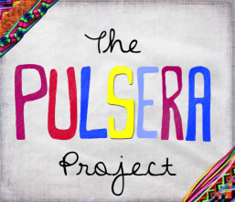
The Pulsera Project is a non-profit organization that empowers young Nicaraguan artisans through the sale of their colorful handwoven bracelets (“pulseras” in Spanish) in the United States. Through pulsera sales almost 100 artisans are empowered through sustainable fair-trade employment, and all proceeds from pulsera sales are then reinvested in different programs in Nicaragua---including scholarships, micro-loans, support for the “Si A La Vida” kids shelter, environmental programs, workers rights advocacy, and other educational programs.
We’ll be selling pulseras in the cafeteria Monday December 3rd to Friday the 7th in the cafeteria. Each pulsera is a completely unique & wearable work of art, and comes tagged with the picture and signature of the young artist who made it. At only $5 a piece, pulseras are super affordable and make for extremely thoughtful and inexpensive gifts for absolutely anyone.
So, come support these young artisans and join us in making the world a more colorful place! For more info you can visit www.pulseraproject.org, or check out their Facebook page at www.facebook.com/pulseraproject.
Thanks so much!

Slide 2
Informative Video About the Pulsera Project

Slide 3
Color the World Trailer – Click Picture

Slide 4
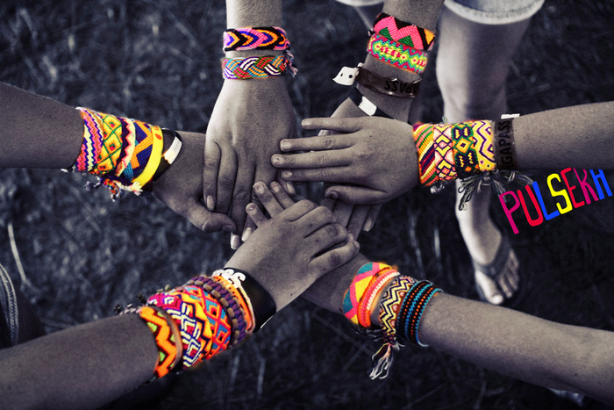
Click Here to See Pictures of a Pulsera Sale

