Slide 1
The Pulsera Project Creating a More Just and Colorful World
Picture from: www.pulseraproject.org
Lesson Created by: Desiree Hanson profehanson.weebly.com

Slide 2
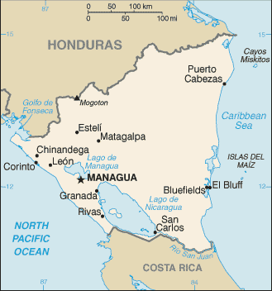
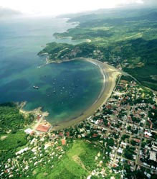
NICARAGUA
Nicaragua is one of the seven countries in Central America. It is situated between Honduras and Costa Rica.
Texas is 5 times bigger than Nicaragua.
Nicaragua is a very beautiful country with rainforests, volcanoes and surrounded by beaches. It’s a very common tourist location.
Pictures from: http://travel.state.gov/travel/cis_pa_tw/cis/cis_985.html and http://www.explorenicaragua.com/
Information from: http://lacesoutdain.wordpress.com/

Slide 3
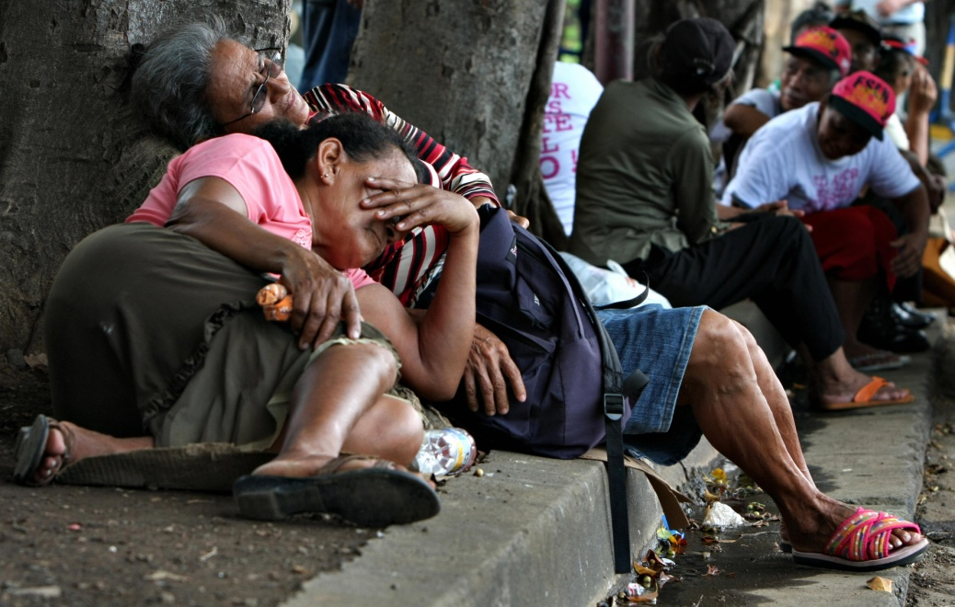
Poverty
45% of Nicaraguans live with less than $1 and 80% live on less than $2 a day. As much as 30% of the total population suffers malnourishment.
Information and Picture from: http://habitatglobalvillage.ca/tripschedulec235.php?PJID=401
http://infosurhoy.com/cocoon/saii/xhtml/en_GB/features/saii/features/2009/06/29/feature-03

Slide 4
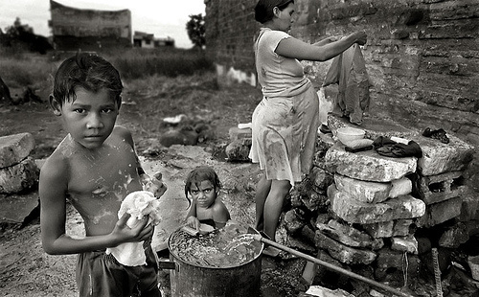
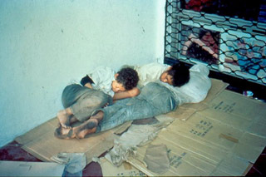
Poverty
Nicaragua is the second poorest country in the western hemisphere, behind Haiti.
Education is free but many children can’t go because they can’t afford supplies nor uniforms or they stop going to school to work to support their family.
In Nicaragua, 20% of students don’t attend elementary school and 60% of students don’t attend high school. In the US, 3% of students 5 to 17 year olds don’t attend school.
32 out of 100 Nicaraguans are illiterate while only 1 in 100 Americans are illiterate.
(15 years or older who cannot read nor write)
Pictures from: http://lacesoutdain.wordpress.com/ and http://www.casa-alianza.org.uk/northsouth/CasaWeb.nsf/Casa_News/Nicaragua_appeal?OpenDocument
Information from: http://habitatglobalvillage.ca/tripschedulec235.php?PJID=401 and https://www.cia.gov/library/publications/the-world-factbook/geos/nu.html
http://www.census.gov/prod/2011pubs/p20-564.pdf

Slide 5
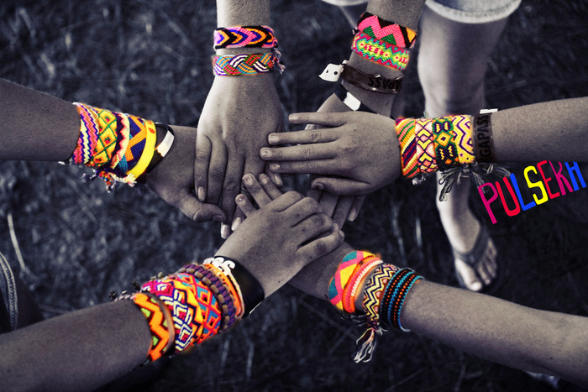
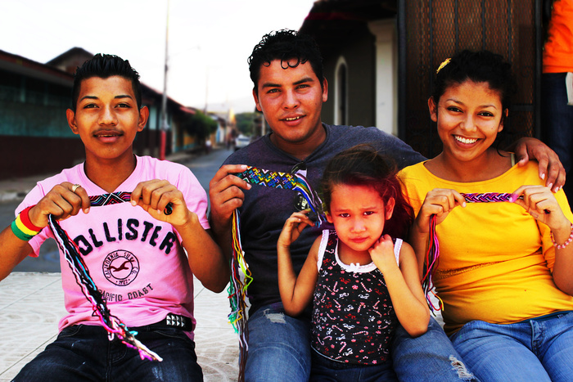
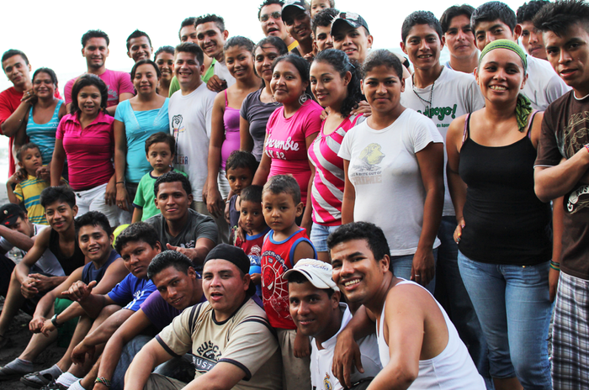
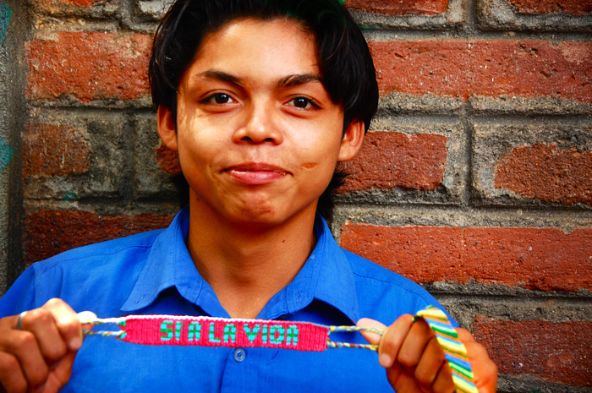
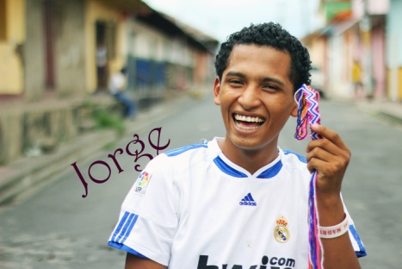
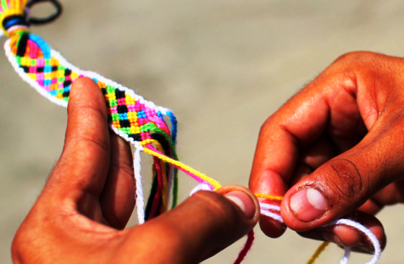
Pulsera Project
Pictures from: www.pulseraproject.org

Slide 6
Color the World Video (Click Picture)
Picture from: www.pulseraproject.org

Slide 7
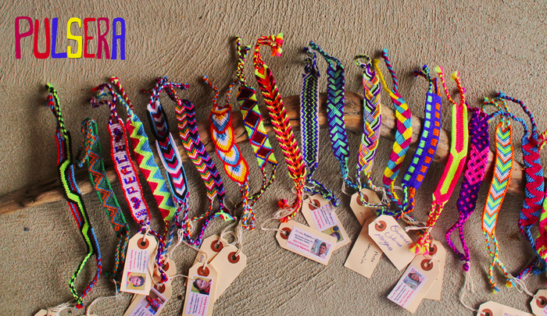
You have an opportunity to help Nicaraguans and help break the cycle of poverty, making the world a more colorful place!
Pulseras will be sold in the cafeteria Dec 5-10.
Each pulsera is a completely unique & wearable work of art, and comes tagged with the picture and signature of the young artist who made it.
Pictures from: www.pulseraproject.org

