Slide 1
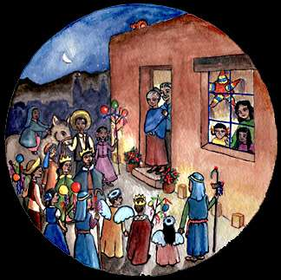
LAS POSADAS

Slide 2
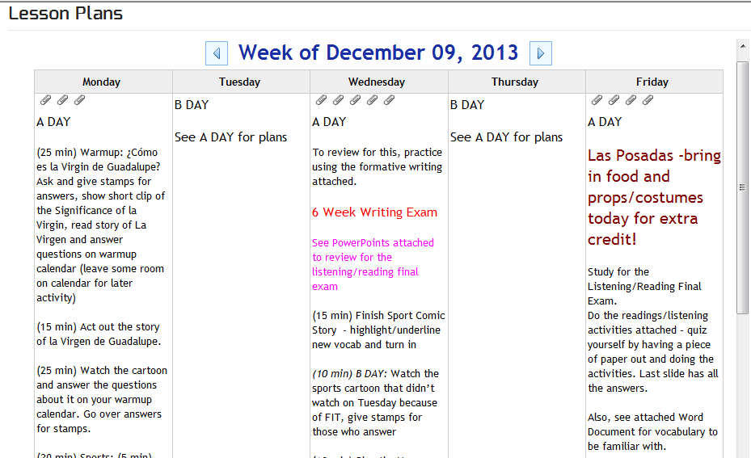
Hoy es viernes, el 13 de diciembre
Para estudiar para la parte de escuchar y leer del examen final ve a profeh.weebly.com
Para el Examen Final: E222
Exámenes Finales
martes: 1 & 5
miércoles: 4 & 6
jueves: 3 & 7
viernes: 8 & 2
Pasen los boletos de baño al frente
Hoy:
1) Practicar la canción para pedir posada 3) ¡Fiesta!
2) Cantar en el pasillo 4) Película sobre Navidad en México

Slide 3
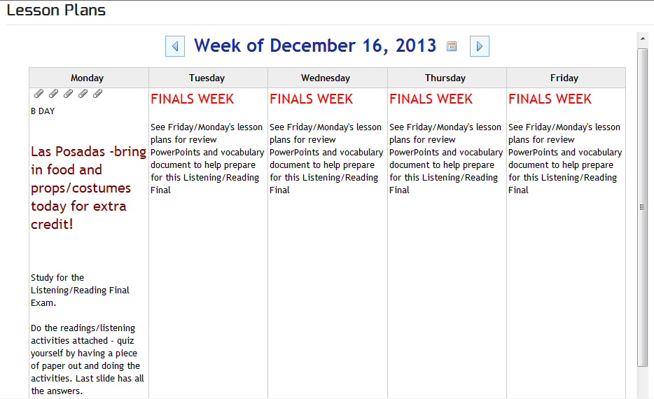
Hoy es lunes, el 16 de diciembre
Para estudiar para la parte de escuchar y leer del examen final ve a profeh.weebly.com
Para el Examen Final: E222
Exámenes Finales
martes: 1 & 5
miércoles: 4 & 6
jueves: 3 & 7
viernes: 8 & 2
Pasen los boletos de baño al frente
Hoy:
1) Practicar la canción para pedir posada 3) ¡Fiesta!
2) Cantar en el pasillo 4) Película sobre Navidad en México

Slide 4
Versos para pedir posada Canción con letra
Los Peregrinos: Gente Afuera
(Travelers)
Los Posaderos: Gente Adentro
(Innkeepers)
Notes:
Holidays/seasonal content

Slide 5
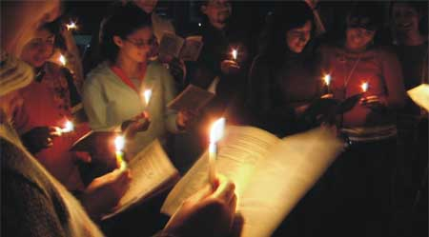
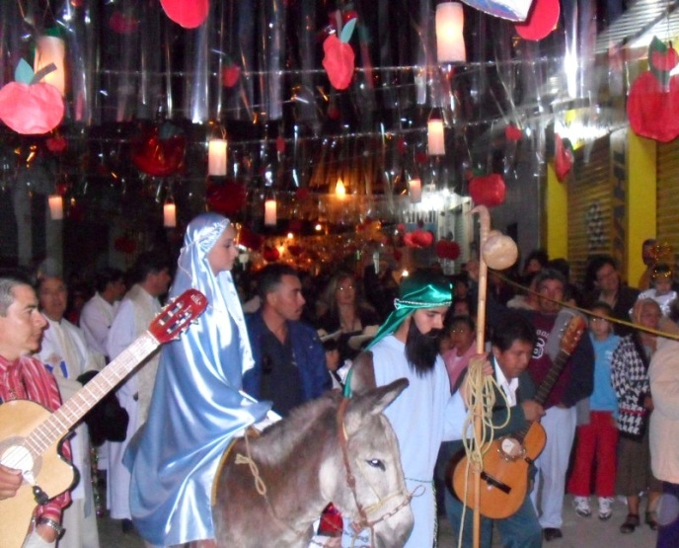
Villancicos
Villancicos son partes de la celebración de las Posadas. La gente canta durante la procesión y cuando entra “la posada” (la casa)
Notes:
Holidays/seasonal content

Slide 6
Mi Burrito Sabanero
Grasslands donkey

Slide 7
Cascabel
Jingle Bells

Slide 8
Feliz Navidad
Merry Christmas

Slide 9
Los Peces en el Río
The Fish in the River

Slide 10
Noche de Paz
Holy Night

Slide 11
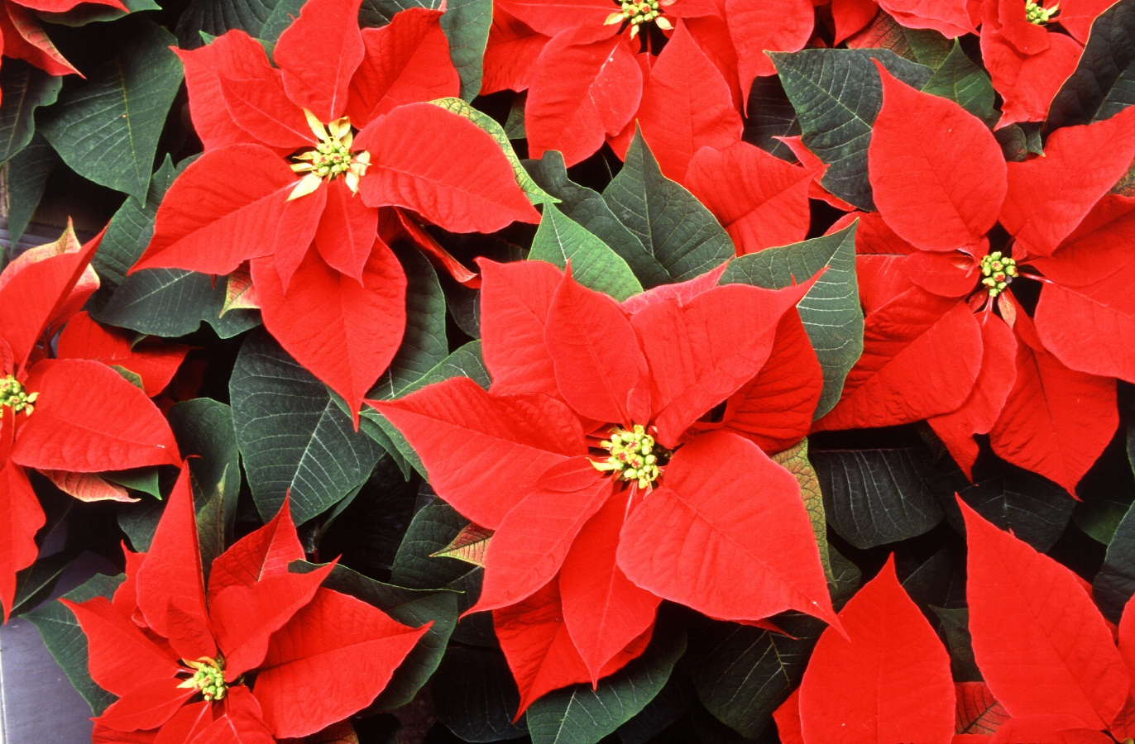
La Flor de Nochebuena

Slide 12
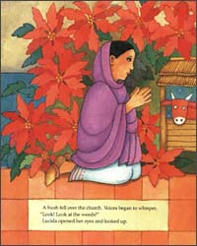
La Leyenda de la Flor de Nochebuena
There was a poor girl named María or Pepita and her little brother Pablo or cousin Pedro depending on who tells the story. She was very sad, being so poor that she had nothing to give baby Jesus in the manger scene in the Village Church.
On Christmas Eve ( Noche Buena) on the way to the church Maria picked some weeds to make a bouquet to bring to the manger scene. Her little brother said to her “it does not matter what she gives as long as it was given in love”. The children of the village, of course teased them until they saw the plants turn from green to a bright red on top right before their eyes as María knelt at the alter.
The whole village then realized they had just witnessed a true Christmas miracle and from that day on the plant became known as the “Flor de Noche Buena”.

Slide 13
Otra Versión

Slide 14
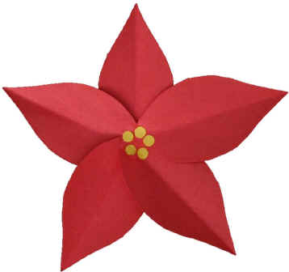
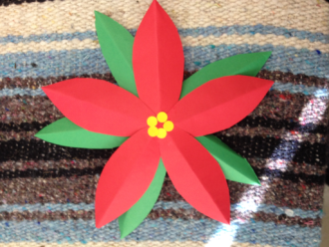
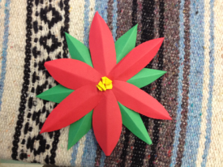
La Flor de NocheBuena
Get a quarter piece of red paper and a quarter piece of green. Fold the red 3 times hot dog style so skinny. Do same with the green.
On top half of hot dog, cut a half petal shape out along the fold, so that when you open your petal it's symmetrical (the same on both sides) with a fold down the center. Repeat with bottom half of hot dog. You will have 8 petals/leaves.
Cut a few strips of yellow paper and scrunch up and glue.
Assemble your flower by gluing the red petals in a circle and gluing the yellow dots in the center. Glue green petals behind for leaves.
Give to your maestro/a, mamá, abuela o amigo/a
¡Feliz Navidad!

Slide 15
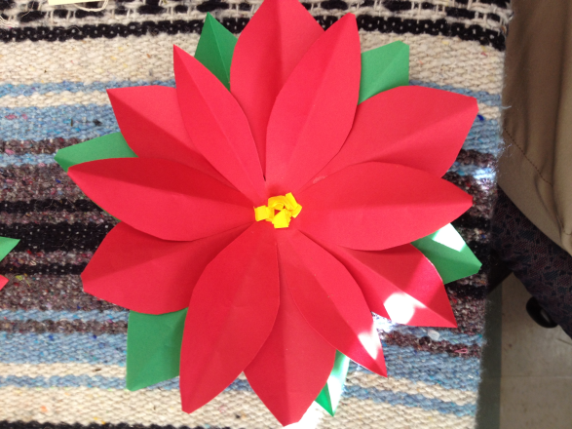
Otra versión de hacer una flor de Nochebuena
This one is a bit more work
It requires 3 pieces of paper – 2 red for flower and 1 for green.
When cutting make a point on both ends
Yellow pieces crumpled up for inside.

