Slide 1
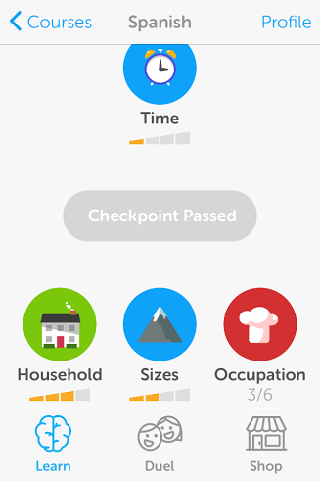
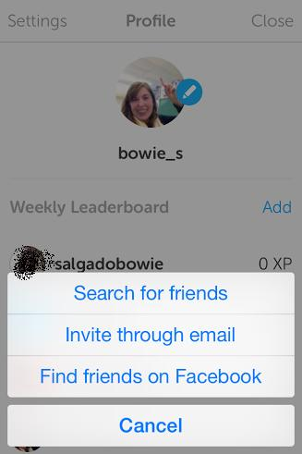
Now you are ready to turn in homework
Click Add to right of Weekly Leaderboard
Click Search for Friends and type the username of your friend. Have your friend do the same so you are both following each other
Click Profile

Slide 2
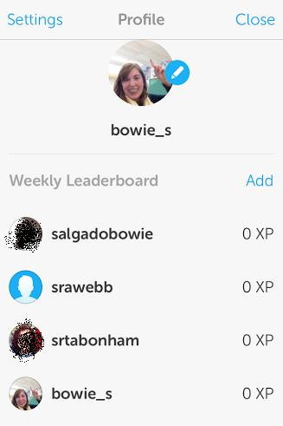
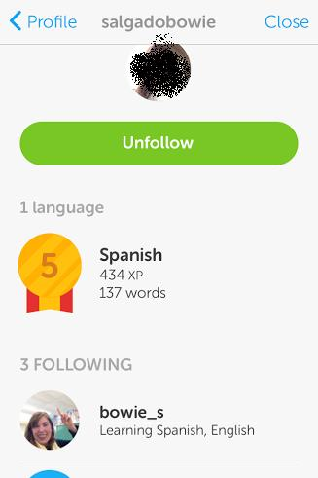
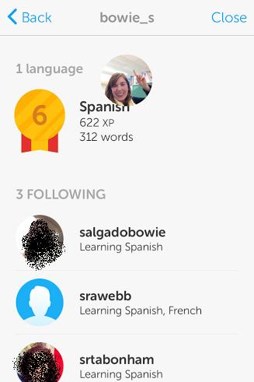
To turn in homework:
Click Profile at top right
Click on a friend that is following you
On your friend’s page, click on your own name
Now you are at the screenshot to turn in that has your username, profile pic, and word count all in one image. Take a screenshot on your phone or computer and upload this image to Edmodo.

