Slide 1
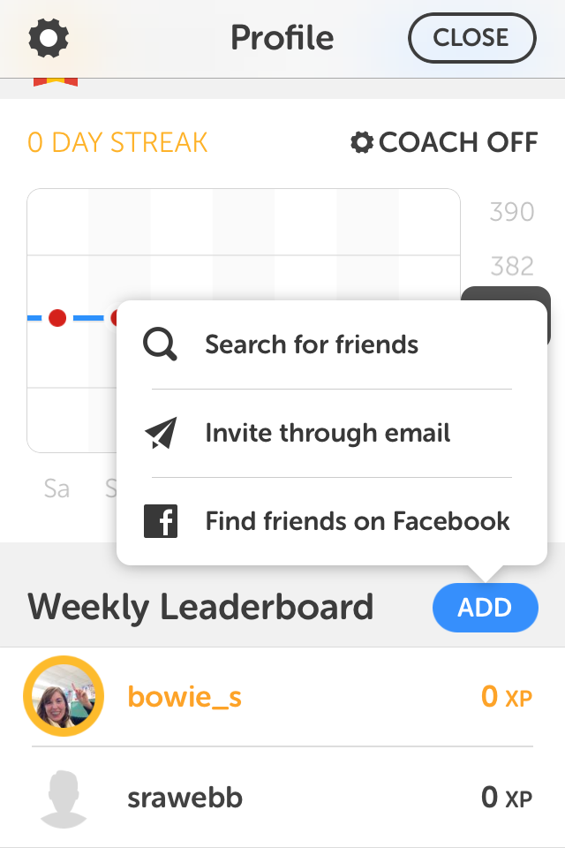
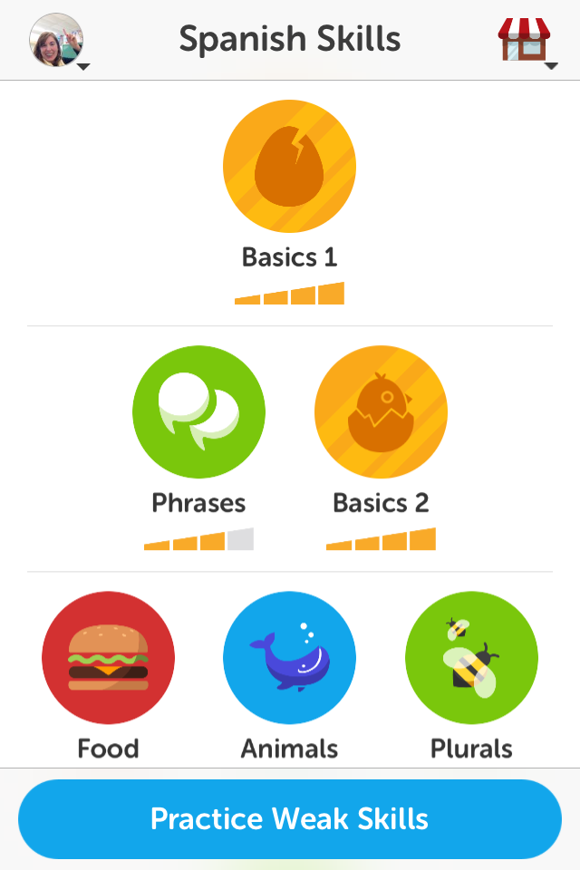
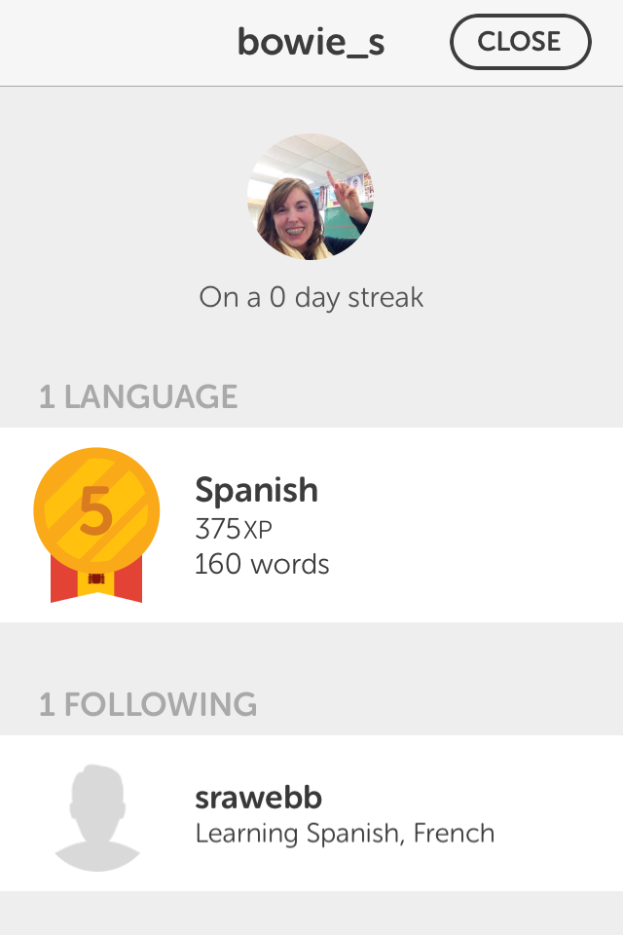
DUOLINGO SCREENSHOT ON PHONE/TABLET
Step #1 Click your profile pic on top left (if you haven’t taken one, do so)
Step #2 Click “Add” at bottom of Leaderboard
Step #3 Click “Search for friends” and add one of your friends
HOMEWORK SCREENSHOT
Step #4 When ready for homework screenshot, click on YOUR name on Weekly Leaderboard. This is the screenshot you will upload (has username, picture AND your wordcount!

Slide 2
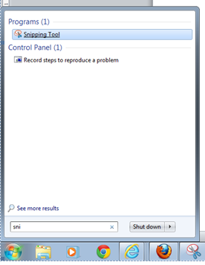
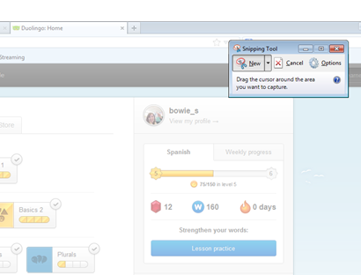
DUOLINGO ON COMPUTER
Click New and screen will grayout, go to starting point left of username and click, hold and drag to include username and word count, let go and save image to desktop.
On PC: Click Start Button, type “Snipping Tool” and open
On Mac: Click and drag your cursor to highlight the area you'd like to take a picture of and let go. You will hear a camera sound and find the image on your desktop.

