Slide 1
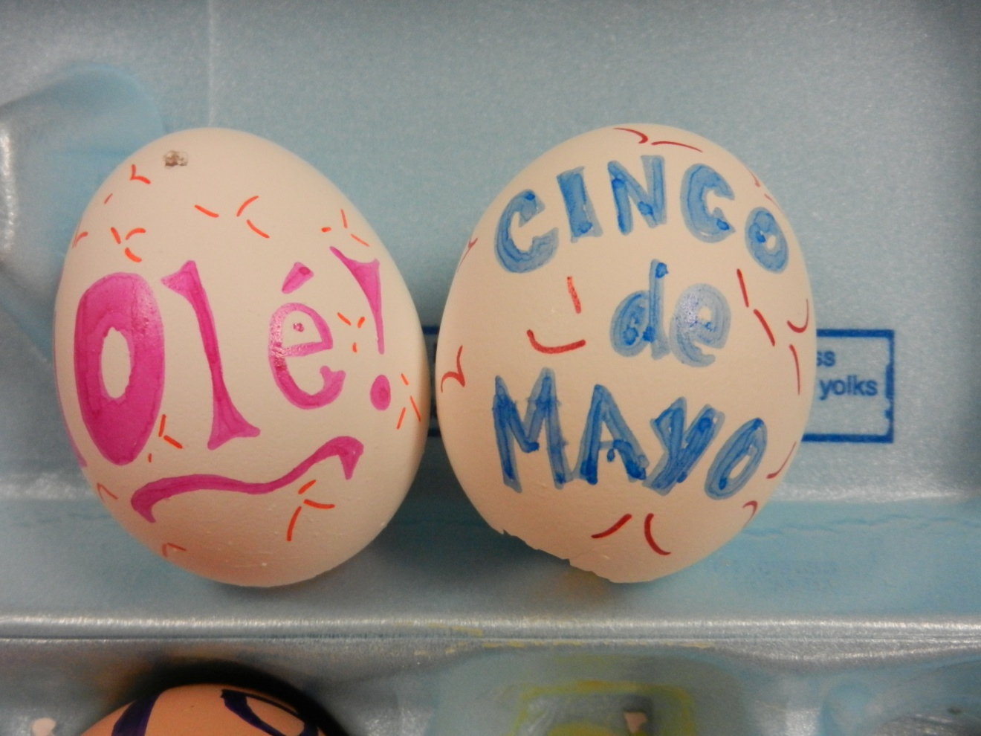
¡CASCARONES!
Grab your eggs
Sit in groups of FOUR!
¡Vamos a hacer 2 cascarones para nuestra fiesta para Cinco de Mayo!

Slide 2
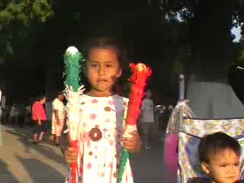
CASCARONES

Slide 3
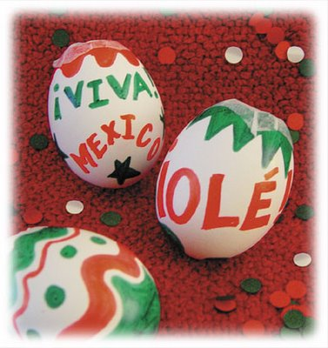
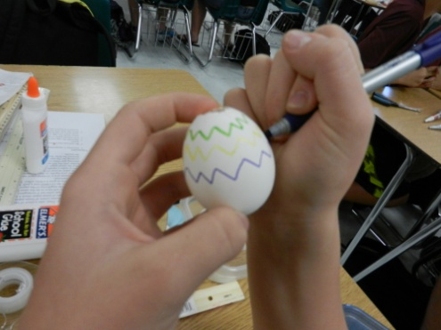
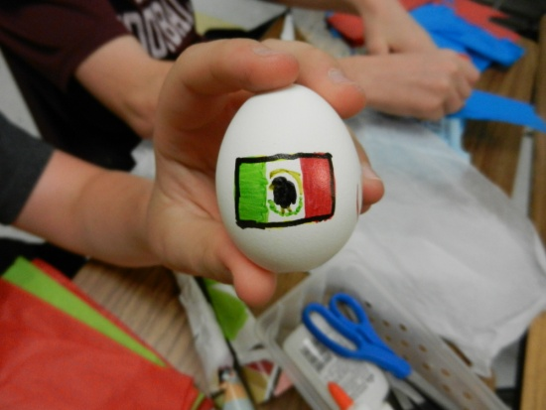
Cascarones
Use permanent markers to decorate the outside of the egg.
You can write these words and phrases as well: “¡Viva México!" “¡Olé!" “Cinco de Mayo” “¡Me gusta español!”, “¡Fiesta!”.
Make sure the big hole is on the BOTTOM
Let the eggs dry completely (about 1 hour)
Image from: http://www.pollyestherchildcare.com/2009/05/early-childhood-education-cinco-de-mayo_02.html

Slide 4
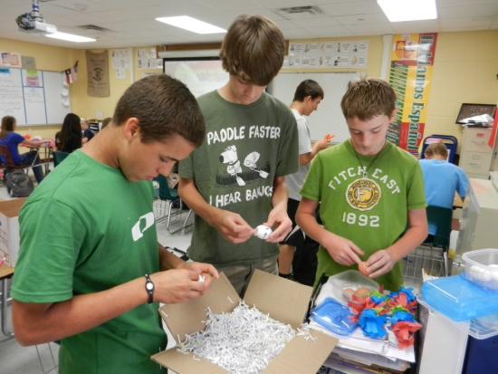
Cascarones
Once dry, fill each egg with confetti.
Cut a 1 inch square of colored tissue paper for each egg. Use elmers glue to adhere a tissue square over each egg opening.
Place your cascarones back in your container to be broken at our Cinco de Mayo fiesta!
Image from: http://www.pollyestherchildcare.com/2009/05/early-childhood-education-cinco-de-mayo_02.html

Slide 5
Hoy es el de
Cinco de Mayo Fiesta Thursday! Bring food & supplies in the morning during tutorials. Things that need to be refrigerated, please bring it in a cooler with ice (we are limited on fridge space!)

Slide 6
¡Hoy es CINCO DE MAYO FIESTA!
GRAB YOUR CASCARONES
NO TOUCHING FOOD RIGHT NOW!
¡Siéntate in your assigned seat!
Follow these instructions:
Calmly & quietly walk down the hall to the outside designated spot – do not disturb other classes through the windows.
Do not break eggs until you are outside in the designated spot.
Do not break an egg over someone who doesn’t want you to.
Do not break an egg in anyone’s face. Tradition is to do OVER the head.
You must help me clean up. Everyone must pick up 10 pieces of trash. The food is calling!
I will assign you lunch detention if you break a rule or get too rowdy. If I have to speak to you more than once, you will receive a referral in addition to the lunch detention.
Let’s go have fun!

