Slide 1
Obra #1: Frida Kahlo - Un Autorretrato Tu Versión Moderna
Take selfie based on Youtuber Selfie video we watched in class and come up with 3 hashtags to describe the selfie in Spanish. Include the Spanish name for the type of selfie.
Print selfie out and write the 3 hashtags and the type of selfie written in Spanish.

Slide 2
Tipos de Selfies
Selfie Duckface
Multi Selfie
Estoy Superfit Selfie
Estoy Aburrida Selfie
Selfie Ascensor
Selfie Borroso (Blurry)
Selfie Animal
Selfie Disfraz
Espejo Selfie
Qué Sueño Selfie
Como Parecer Inocente Selfie
Selfie Turista
Cine Selfie
Bigote Selfie
Selfie Copiloto
Selfie Grupal
Sonríe Mucho Selfie
Selfie YouTuber
Globo Selfie
Época Navideña Selfie
Selfie Intelectual
Qué Frío Selfie
Selfie con Mamí

Slide 3
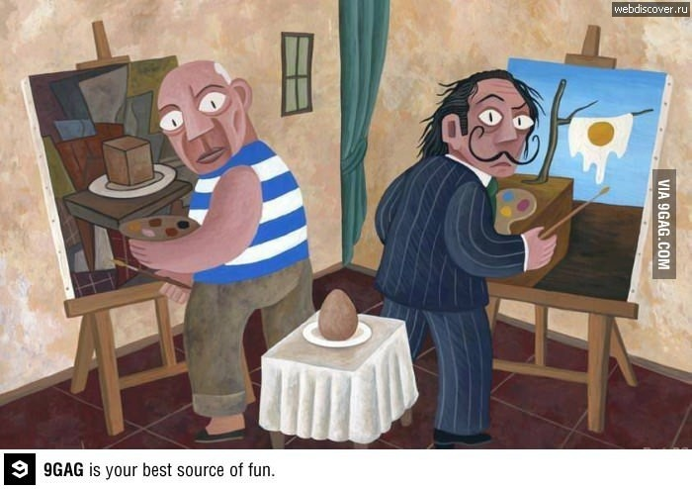
Cubismo vs. Surrealismo

Slide 4
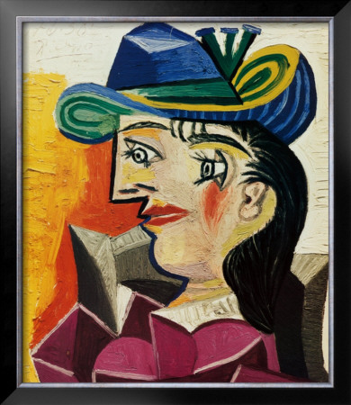
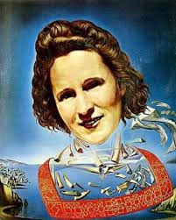
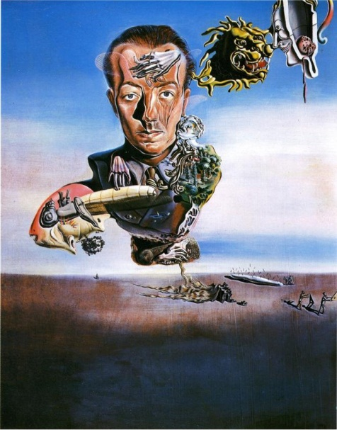
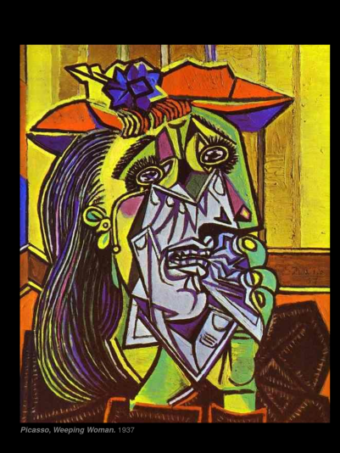
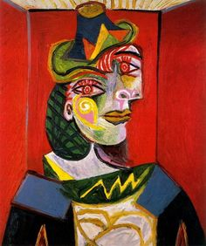
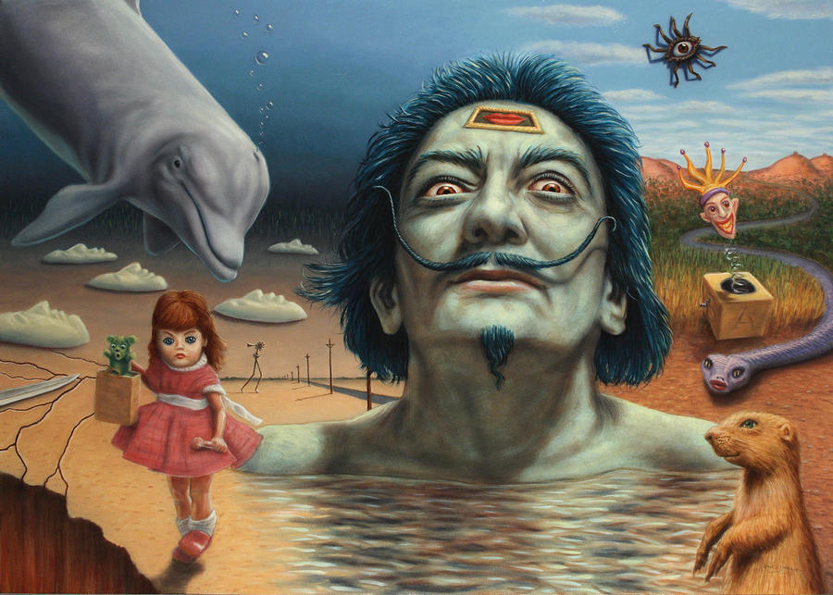
Cubismo vs. Surrealismo

Slide 5
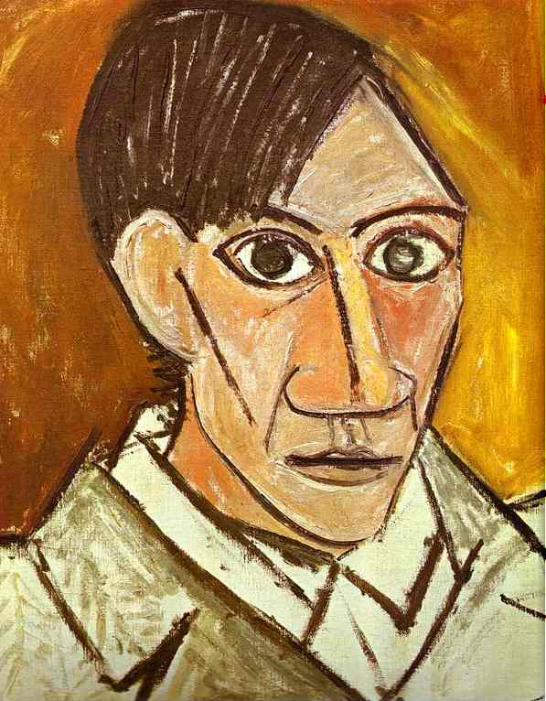
CUBISMO
Cubists proposed that your sight of an object is the sum of many different views and that your memory of an object is not from simply one angle.
A typical cubist work shows real people, places, or objects, but not from a fixed viewpoint. Instead, it shows many parts at one time from many different angles. The whole idea of space is reconfigured- all sides are seen in the work.

Slide 6
Guernica – 3D

Slide 7
Para Construir Un Cuadro Cubista
Start 1:50 to 2:41

Slide 8
Obra #2: Pablo Picasso – Cubismo Tu Versión Moderna
Cubismo Project Requirements:
Cut out parts of at least 8 faces that reflect characteristics of yourself – from different angles
Paste hair and skin on the page
Add features such as nose, eyes, lips, chin, eyebrows
Finish the picture with design, patterns, colored pieces of paper
Write 4 sentences saying what you HAVE DONE to express characteristics of yourself
Notes:
http://practicalpages.wordpress.com/2012/03/16/picassos-portraits/

Slide 9
Información Sobre Salvador Dalí
¿Qué es surrealismo?
¿Quién es Gala?
¿Cuándo se murió Salvador Dalí?
¿Cuál obra es más famosa de Dalí? ¿Dónde está hoy día?
¿Cuántos relojes tiene la obra?
¿Qué bichos (bugs) están en la obra?

Slide 10
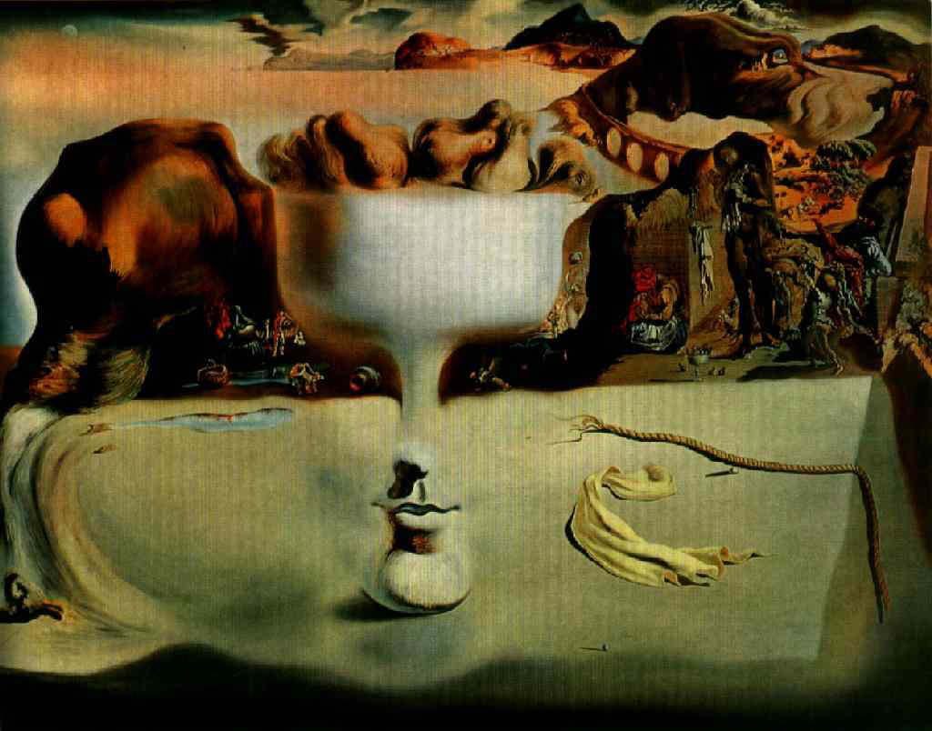
Surrealismo
Surrealism is a form of art that began in the 1920’s. It often shows people, objects, and animals put together in unexpected ways – suggesting images found in dreams and fantasies

Slide 11
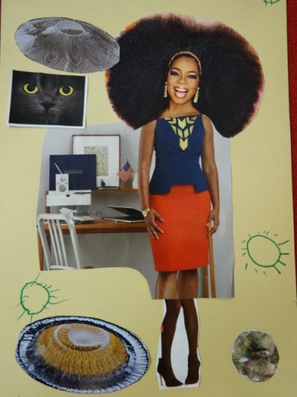
Obra #3: Salvador Dalí – Surrealismo
Tu Versión Moderna
The juxtaposition of disharmonious and unrelated images creating surprise, shock and in this case laughter is an attribute of surrealistic art.
With an image of yourself and at least 4 cut outs from magazines, create a new reconstructed version of yourself!
Include images floating around that represent you and yes they can be puzzling just like Dalí seemed to have puzzling images floating around!
Write 4 sentences of what you HAVE DONE to express things about you as a person
Notes:
http://inspiredmontessori.blogspot.com/2013/09/surrealism-collage-for-preschool.html
http://www.raisingarizonakids.com/2013/02/silly-pictures/

